Slide 1
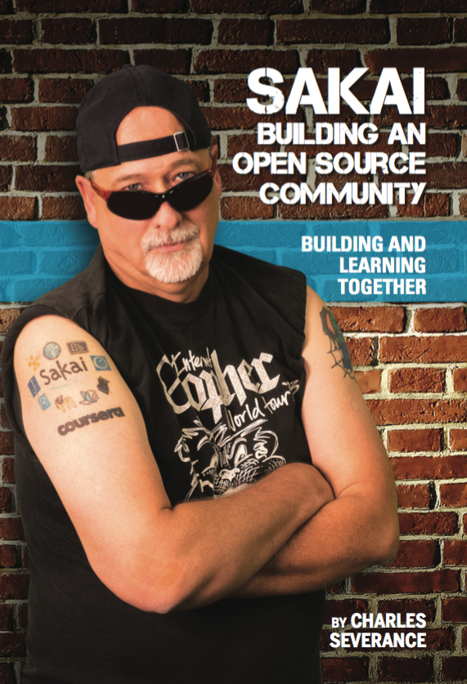
Sakai: Twenty Years of Innovation
Dr. Charles Severance
Sakai PMC Chair

Slide 2
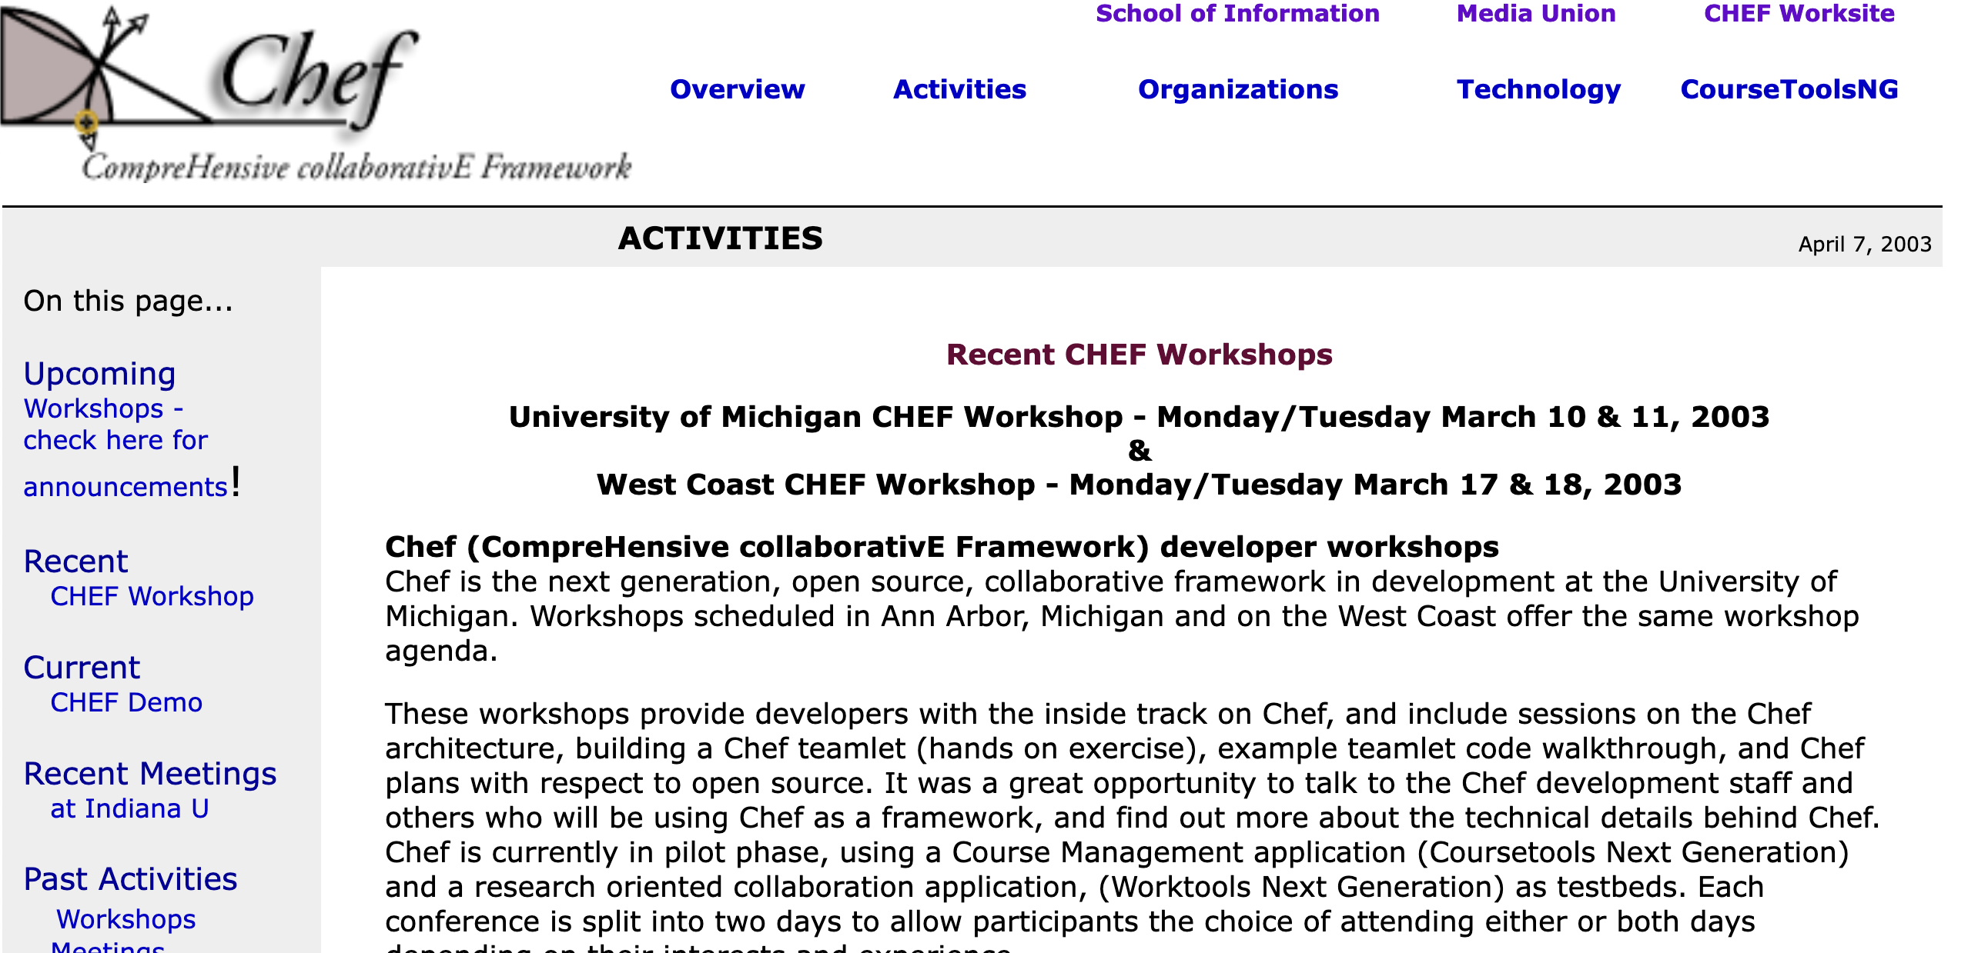
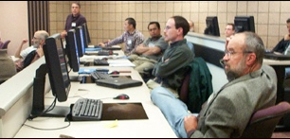
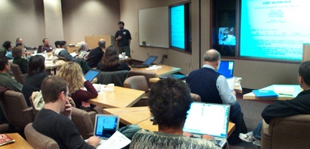
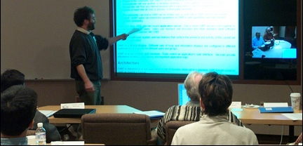
2003

Slide 3
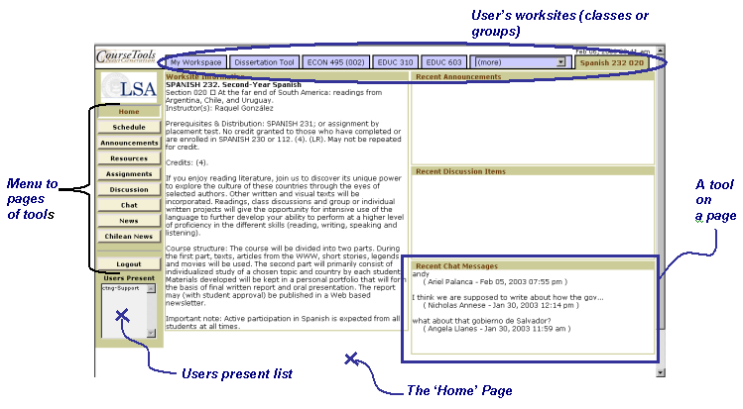

Slide 4
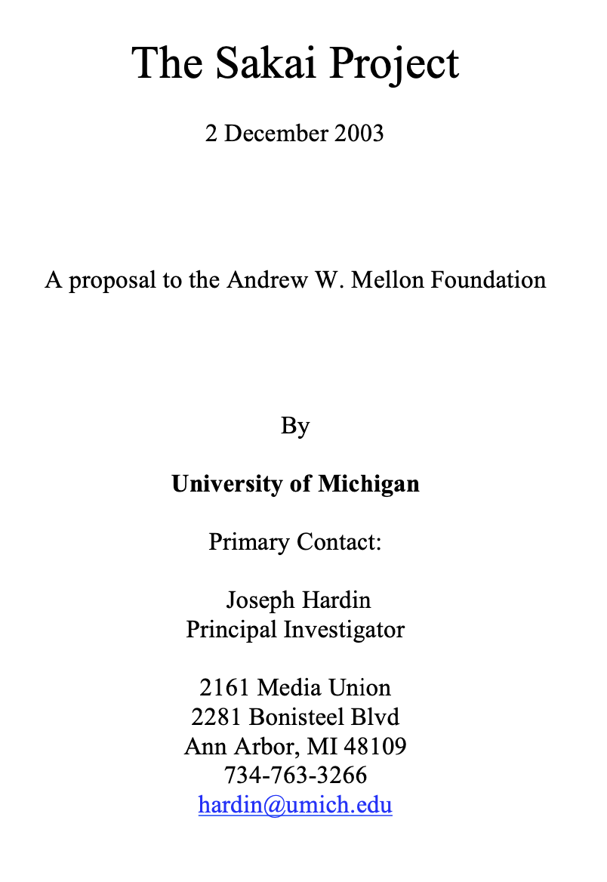
The products of this project will include an Enterprise Services-based Portal, a complete Course Management System with sophisticated assessment tools, a Research Support Collaboration System, a Workflow Engine, and a Tool Portability Profile, i.e., clear standard for writing future tools that can extend this core set of educational applications. ... This effort will demonstrate the compelling economics of “software code mobility” for higher education, and it will provide a clear roadmap for others to follow.

Slide 5
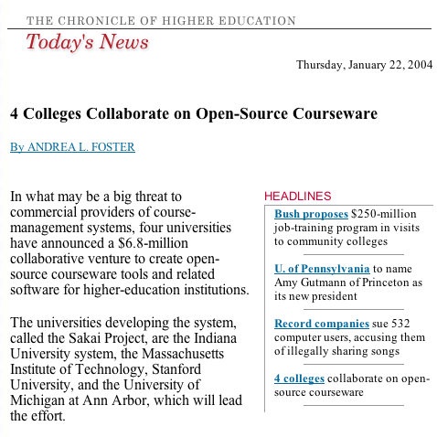

Slide 6
2004 Was a Blur…
Getting to know each other
Interest from around the world – lots of travel / recruitment
Where is the grade book?
Can you impersonate a user?
Is there any way to organize content other than files (like modules)?
JSF? Velocity? Hibernate? Spring?

Slide 7
At the end of 2004
We had our first IMS Tools Interoperability demo scheduled
We released our 1.0 version "on schedule" – it was not fit for production at all
University of Lleida ran it in production Fall 2004 and loved it! (*)
All we knew was that we needed a version 2.0 ASAP!
Jetspeed -> Our own portal and augmented servlet
We needed to switch to a database
And we needed to build new core features during the major upheaval of Sakai 1.0 to Sakai 2.0

Slide 8
The first half of 2005..
Sakai 2.0 was released in June 2005 just in time for our Baltimore Conference
It was an amazing rewrite – long hours and tough choices
The Summer 2005 conference was *packed* - tons of interest
Sakai was growing – it "looked" exponential at the time ☺

Slide 9
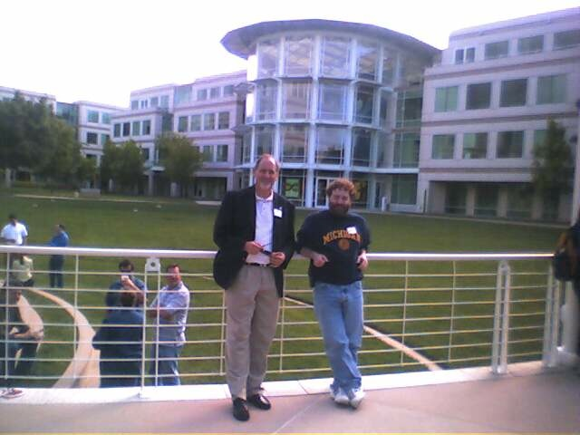
April 27, 2005

Slide 10
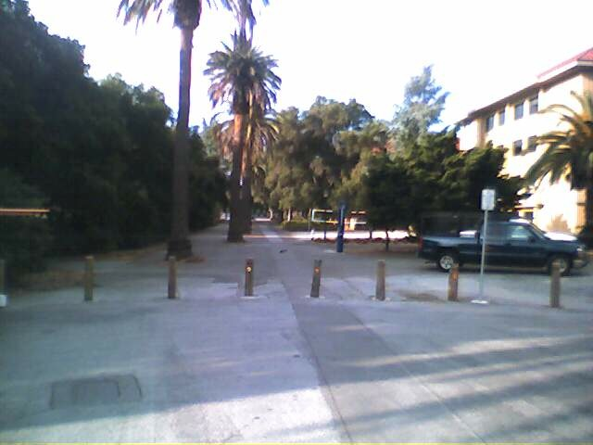
April 29, 2005

Slide 11
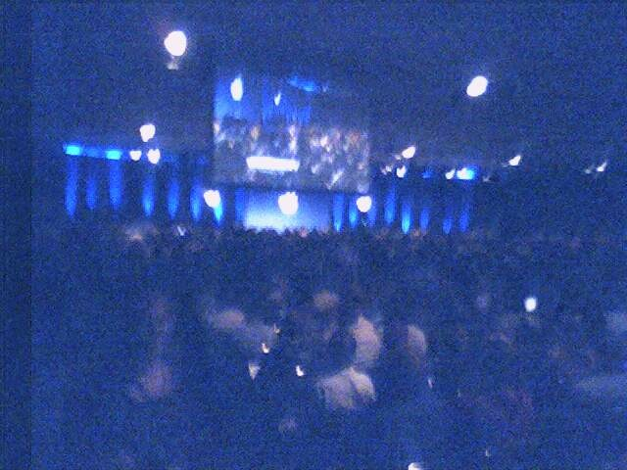
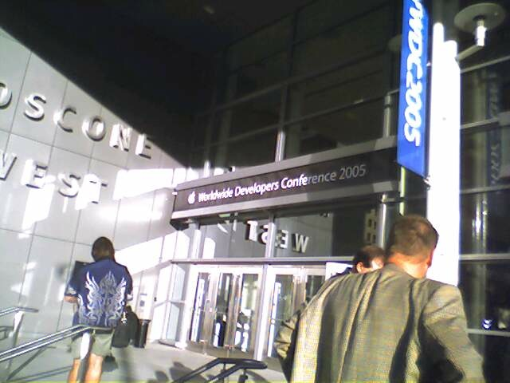
April 27, 2005

Slide 12
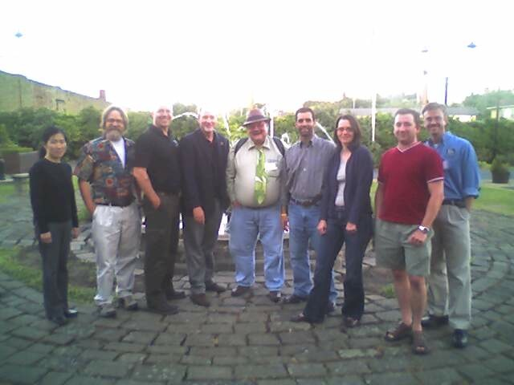
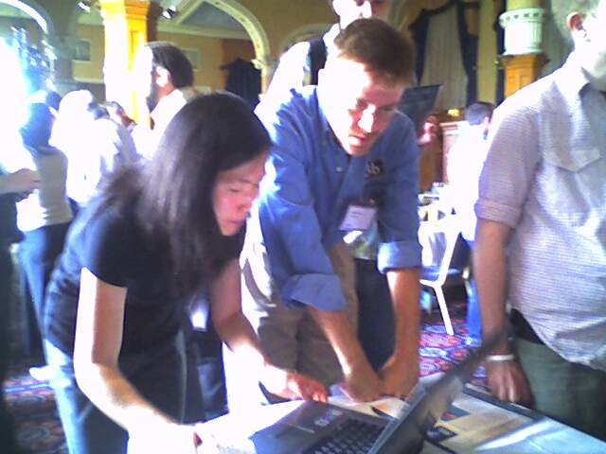
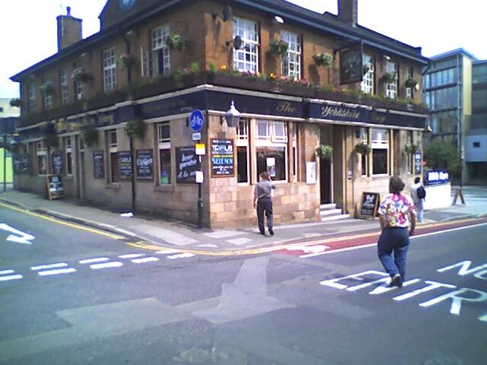
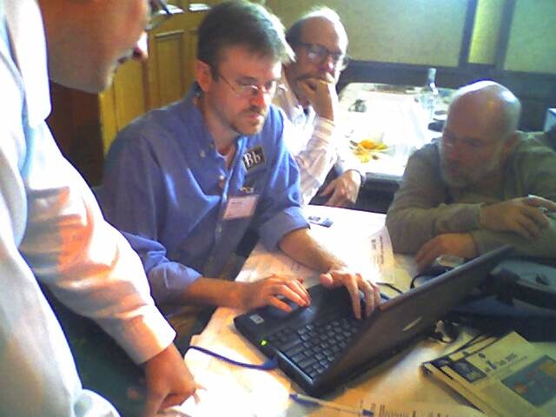
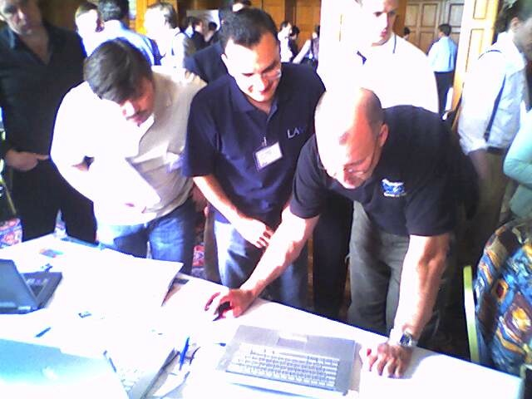
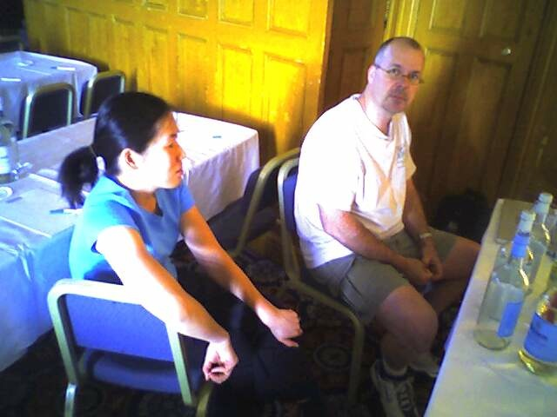
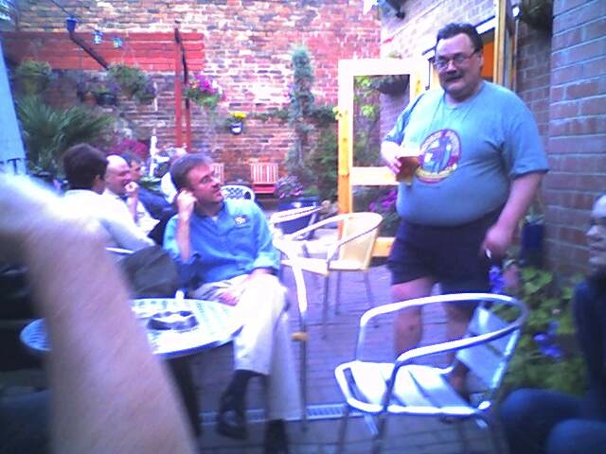
June 2005

Slide 13
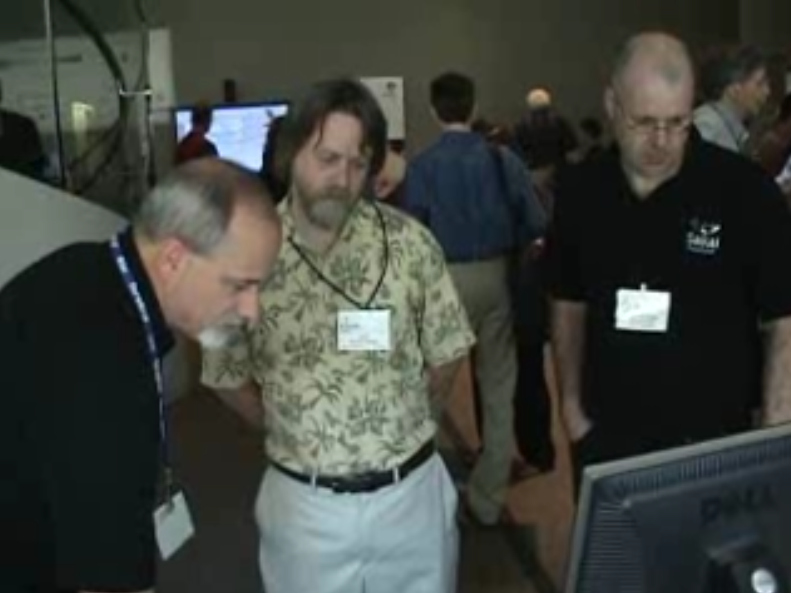
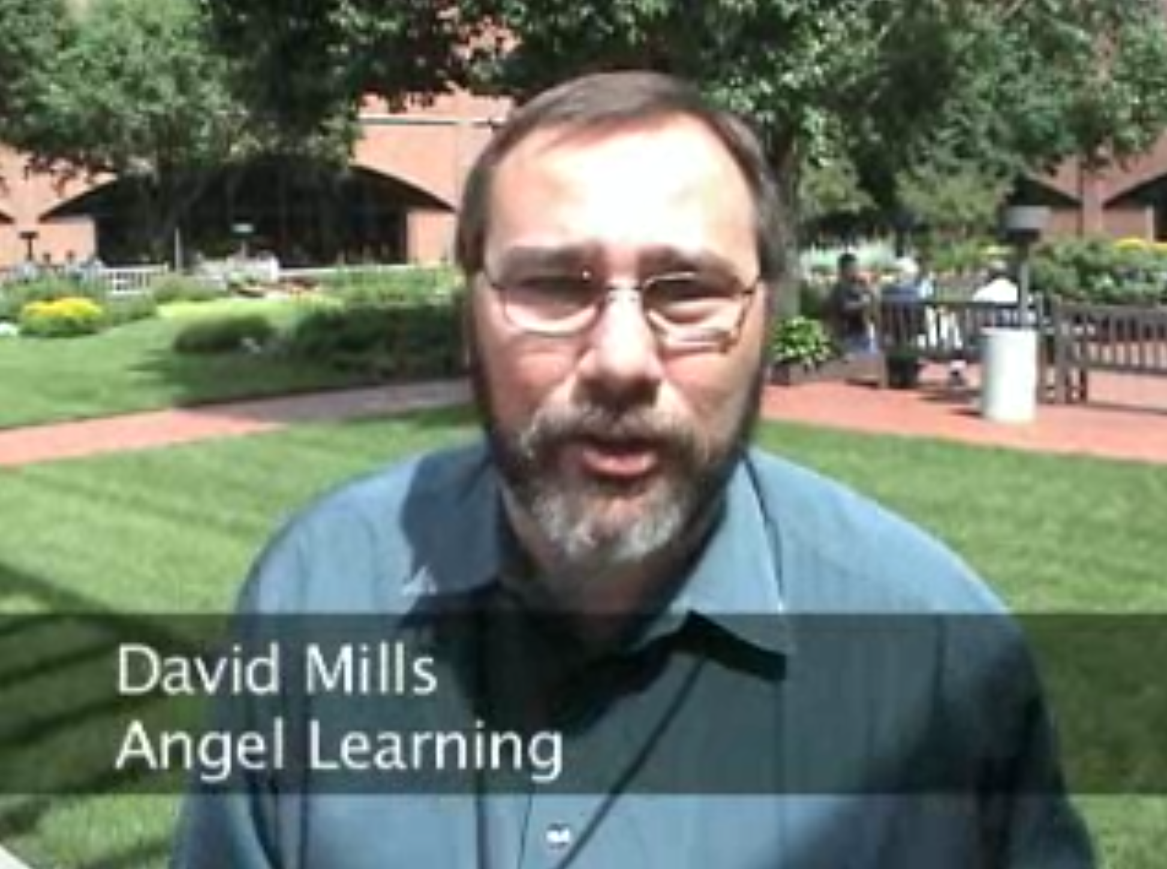

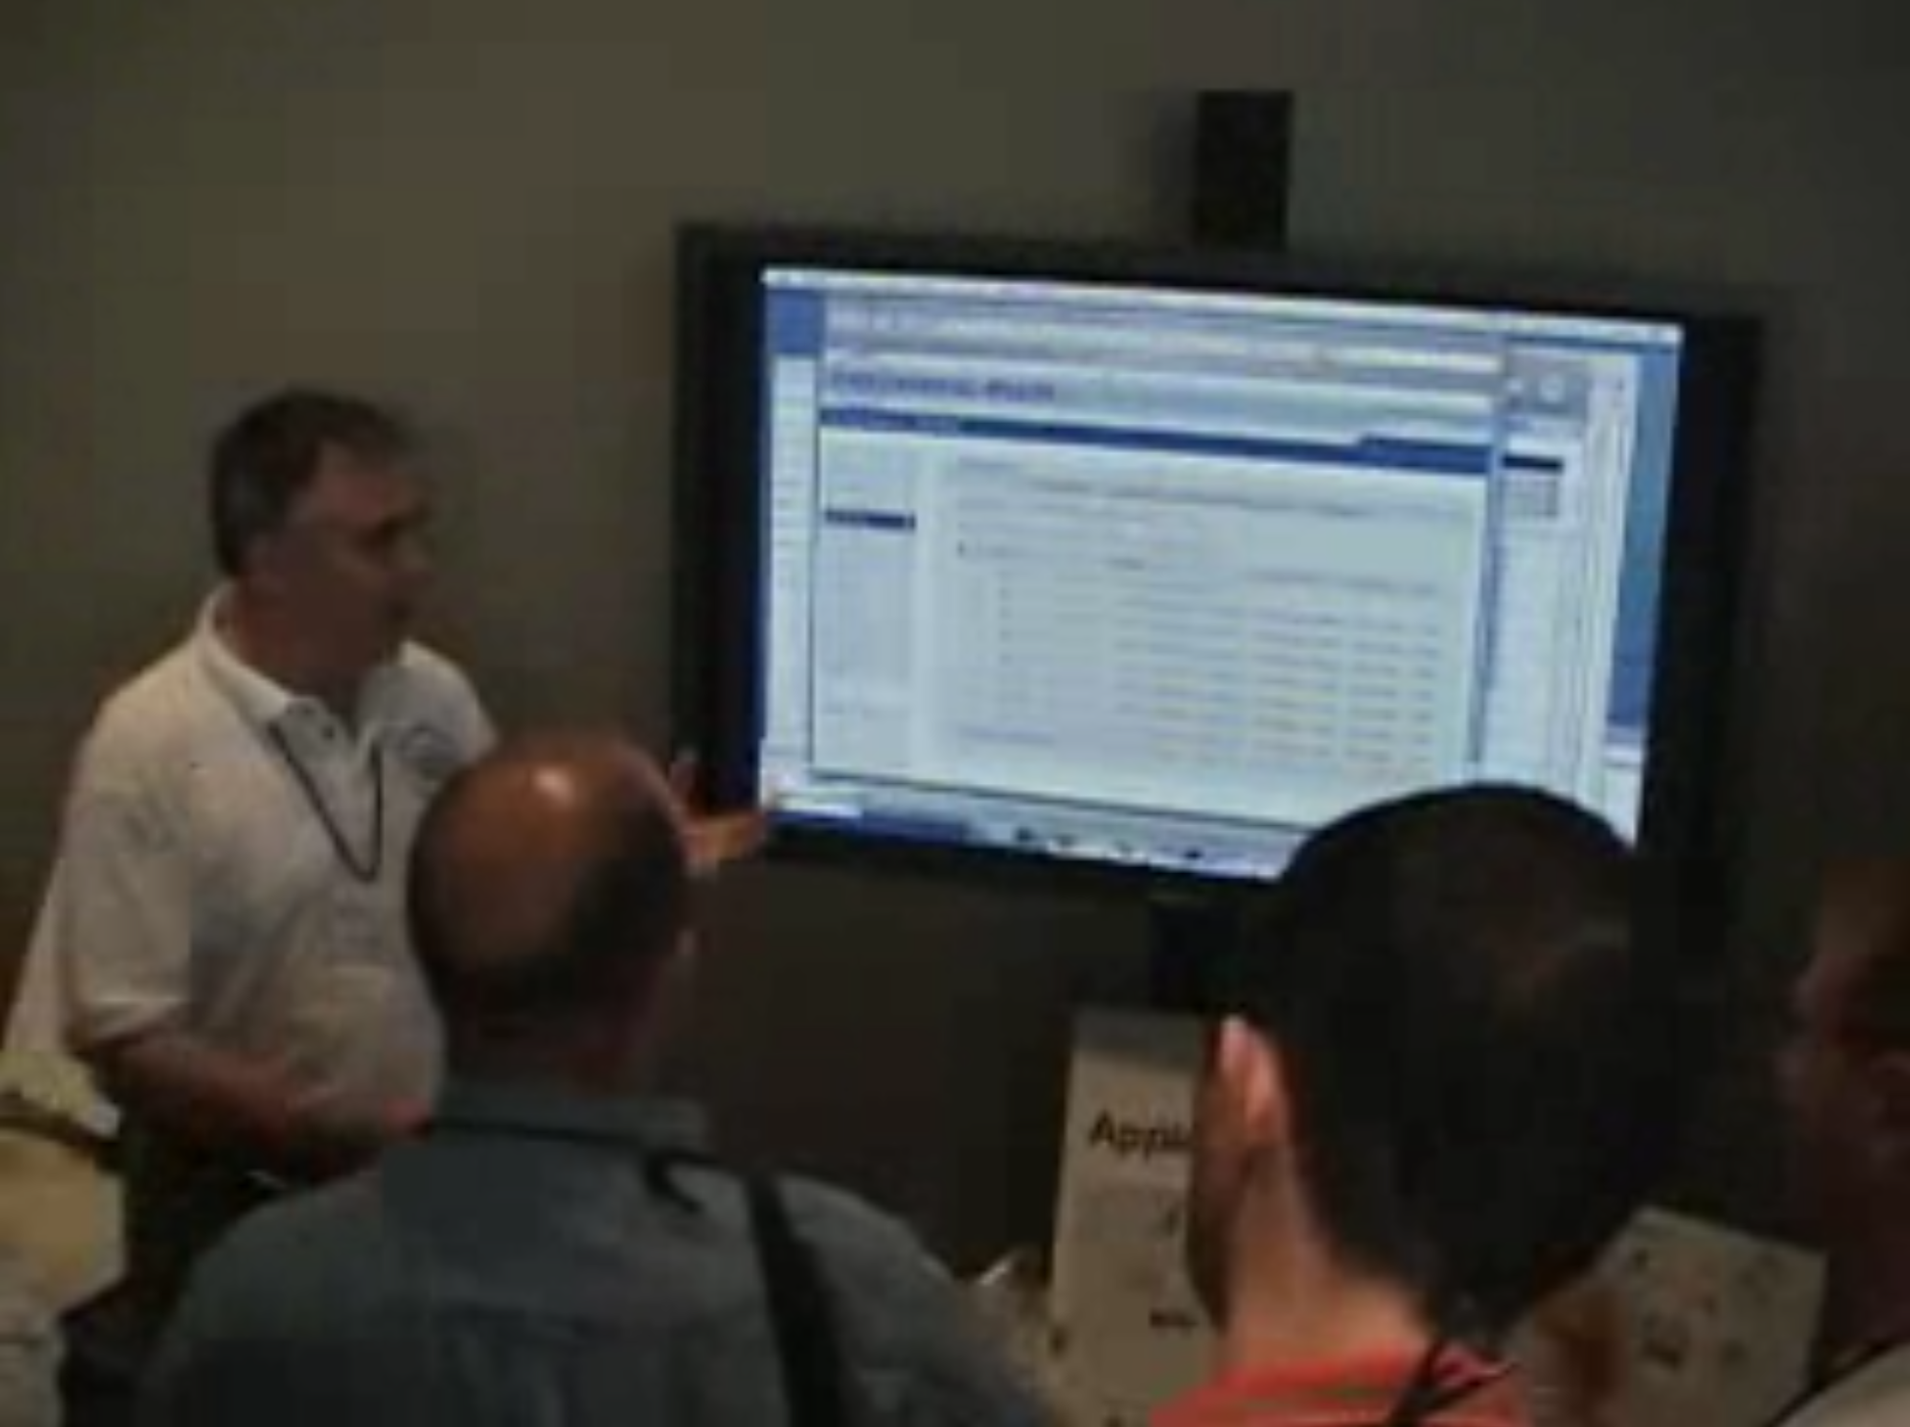
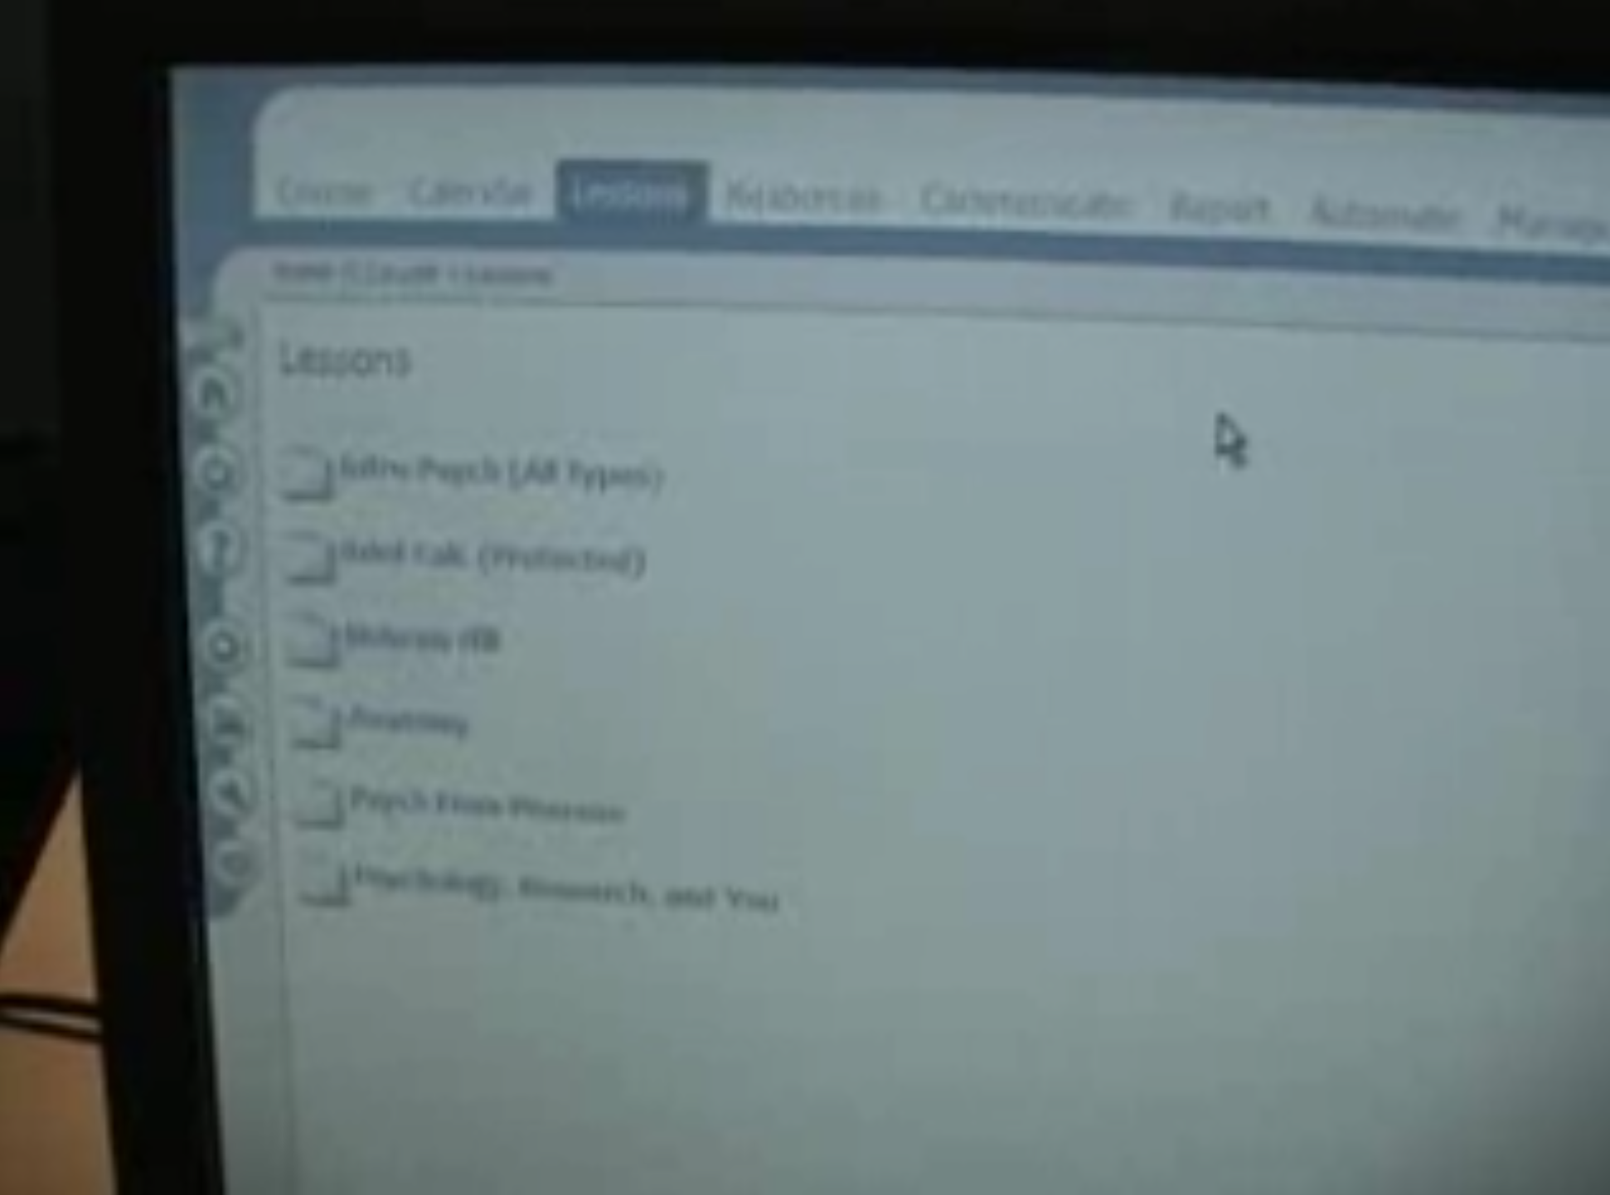
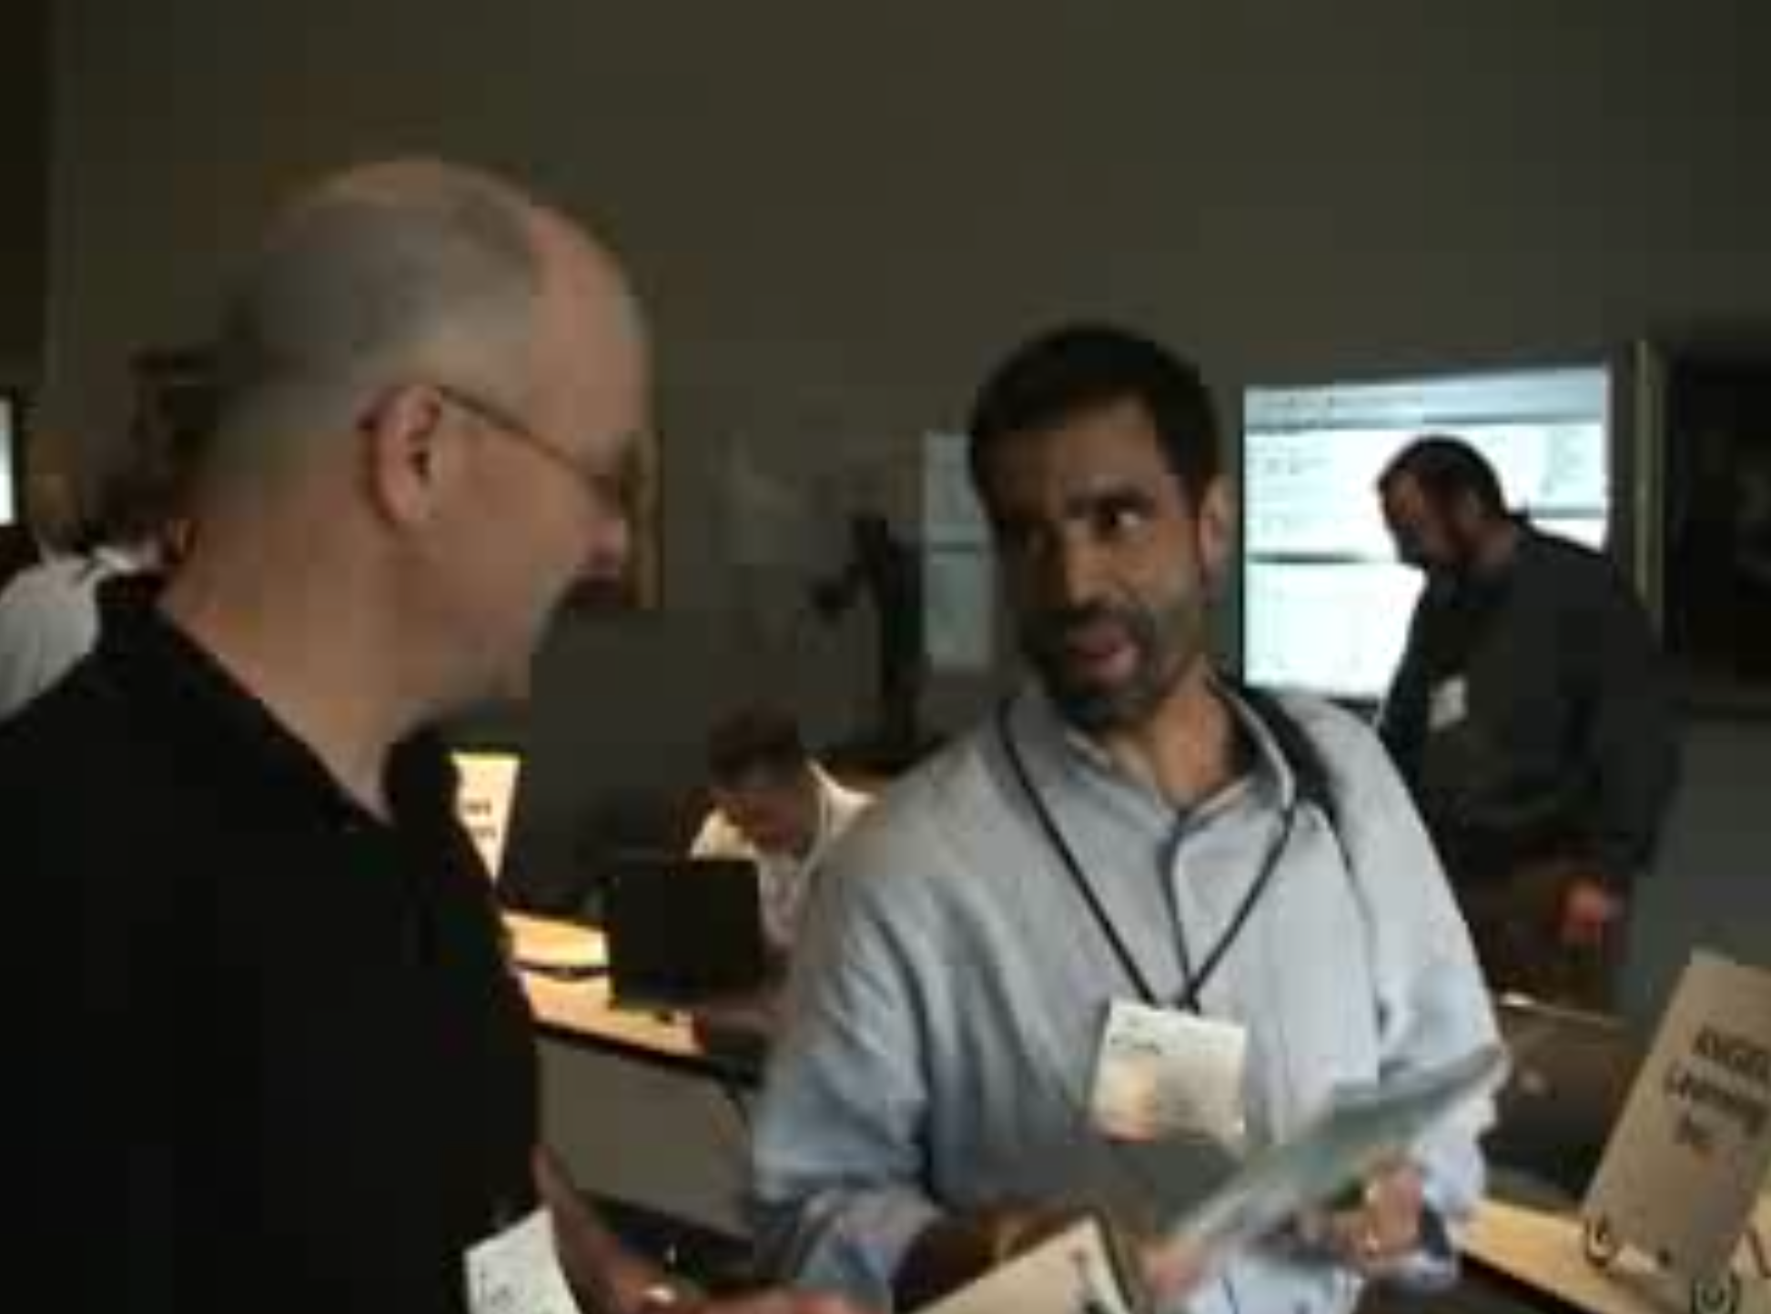
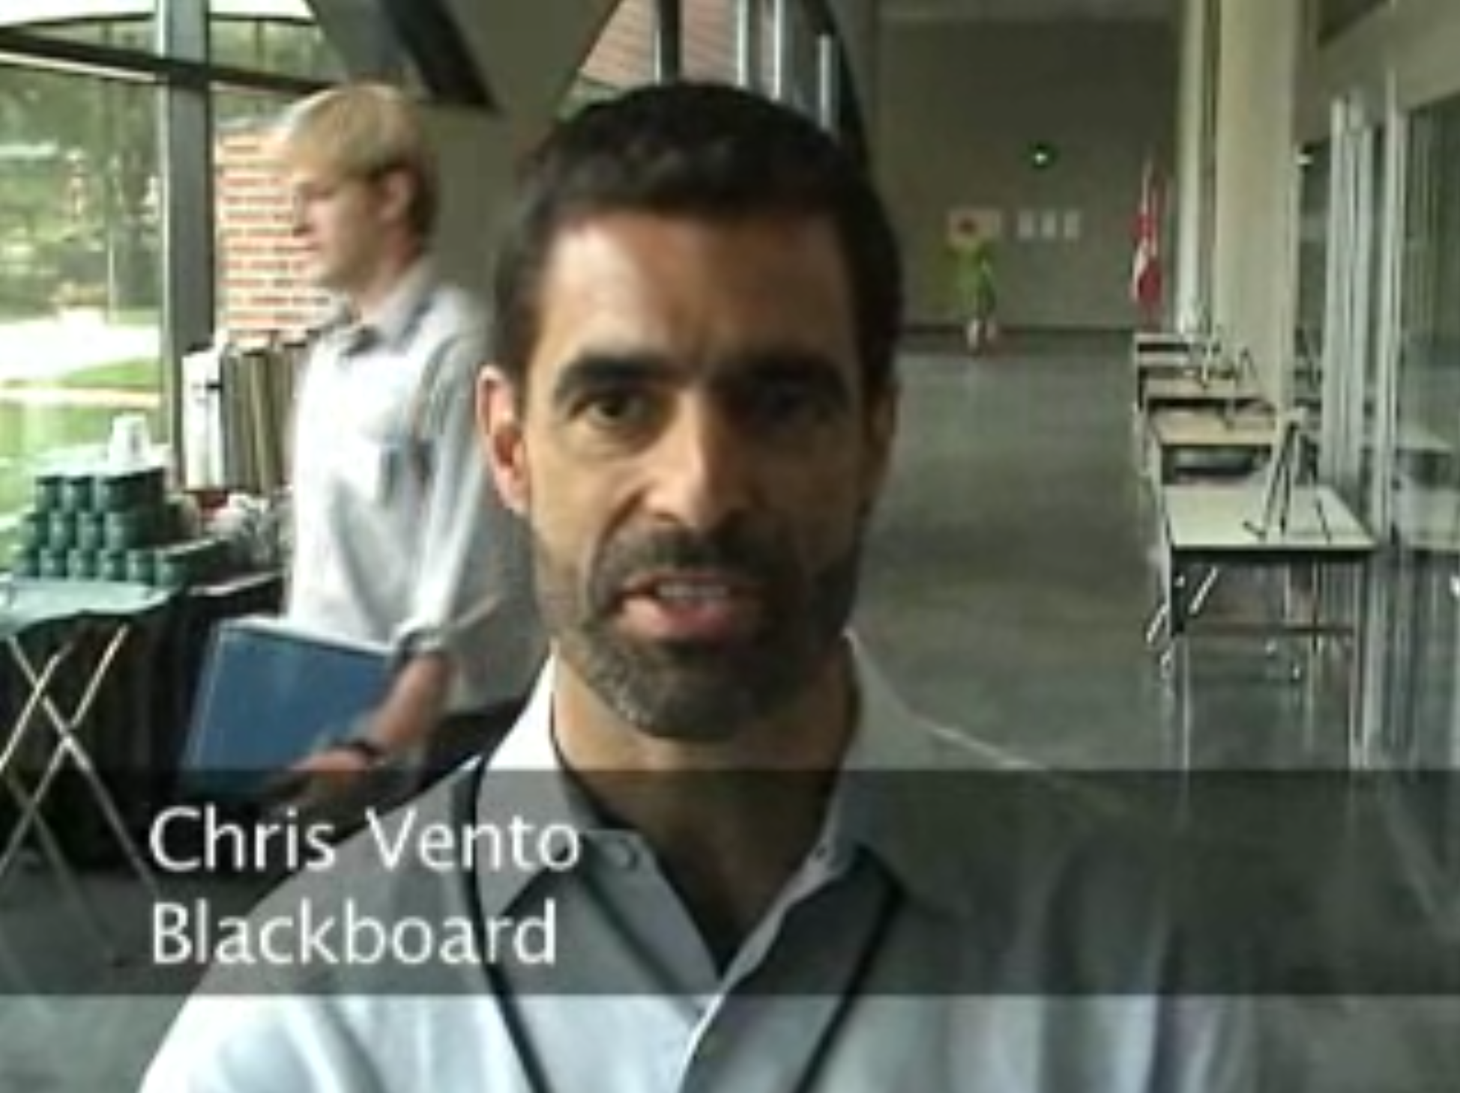
June 2006

Slide 14
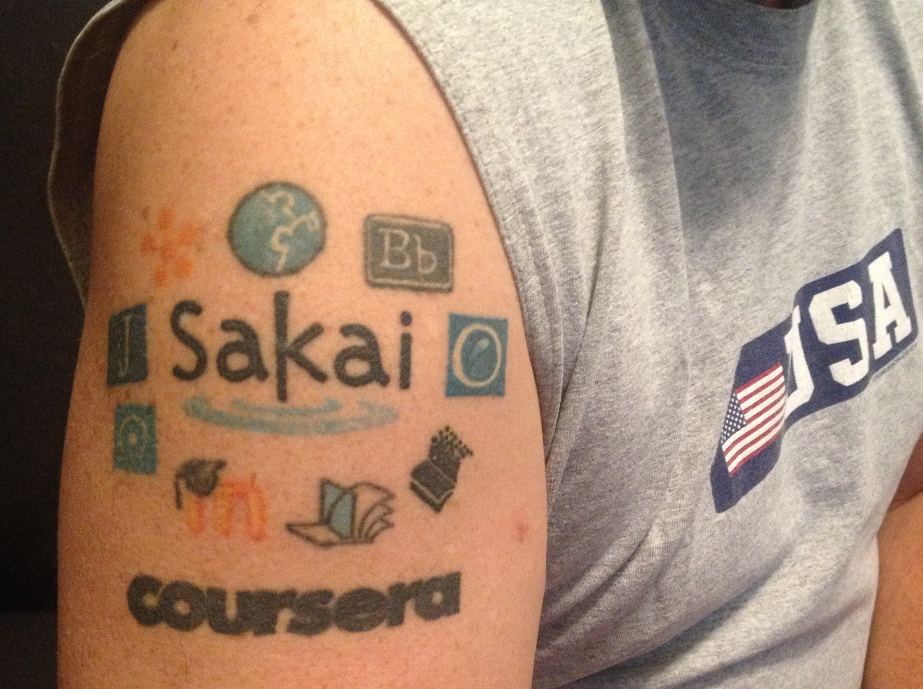
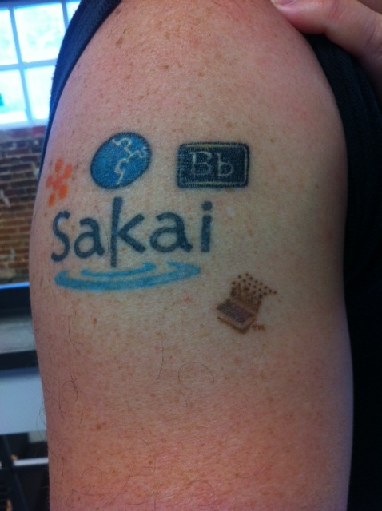
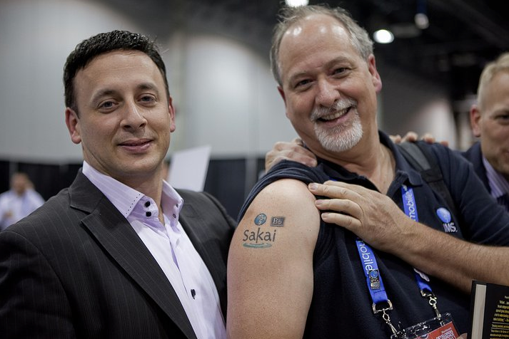
Sakai's fearless innovation, focus on interoperability, and leadership changed the LMS market forever

Slide 15
Goal in 2008: Rewrite Sakai (*)
In 2008, Java seemed like it was fading away and would be replaced by cool new emerging technologies
Ruby on Rails (new language and web framework)
NoSQL and the end of Relational Databases
Backbone (JavaScript framework)
Angular (Another JavaScript framework)
A rewrite would be easy ---- right?
* Dr. Chuck was opposed to this idea – it is why I became a professor in 2007

Slide 16
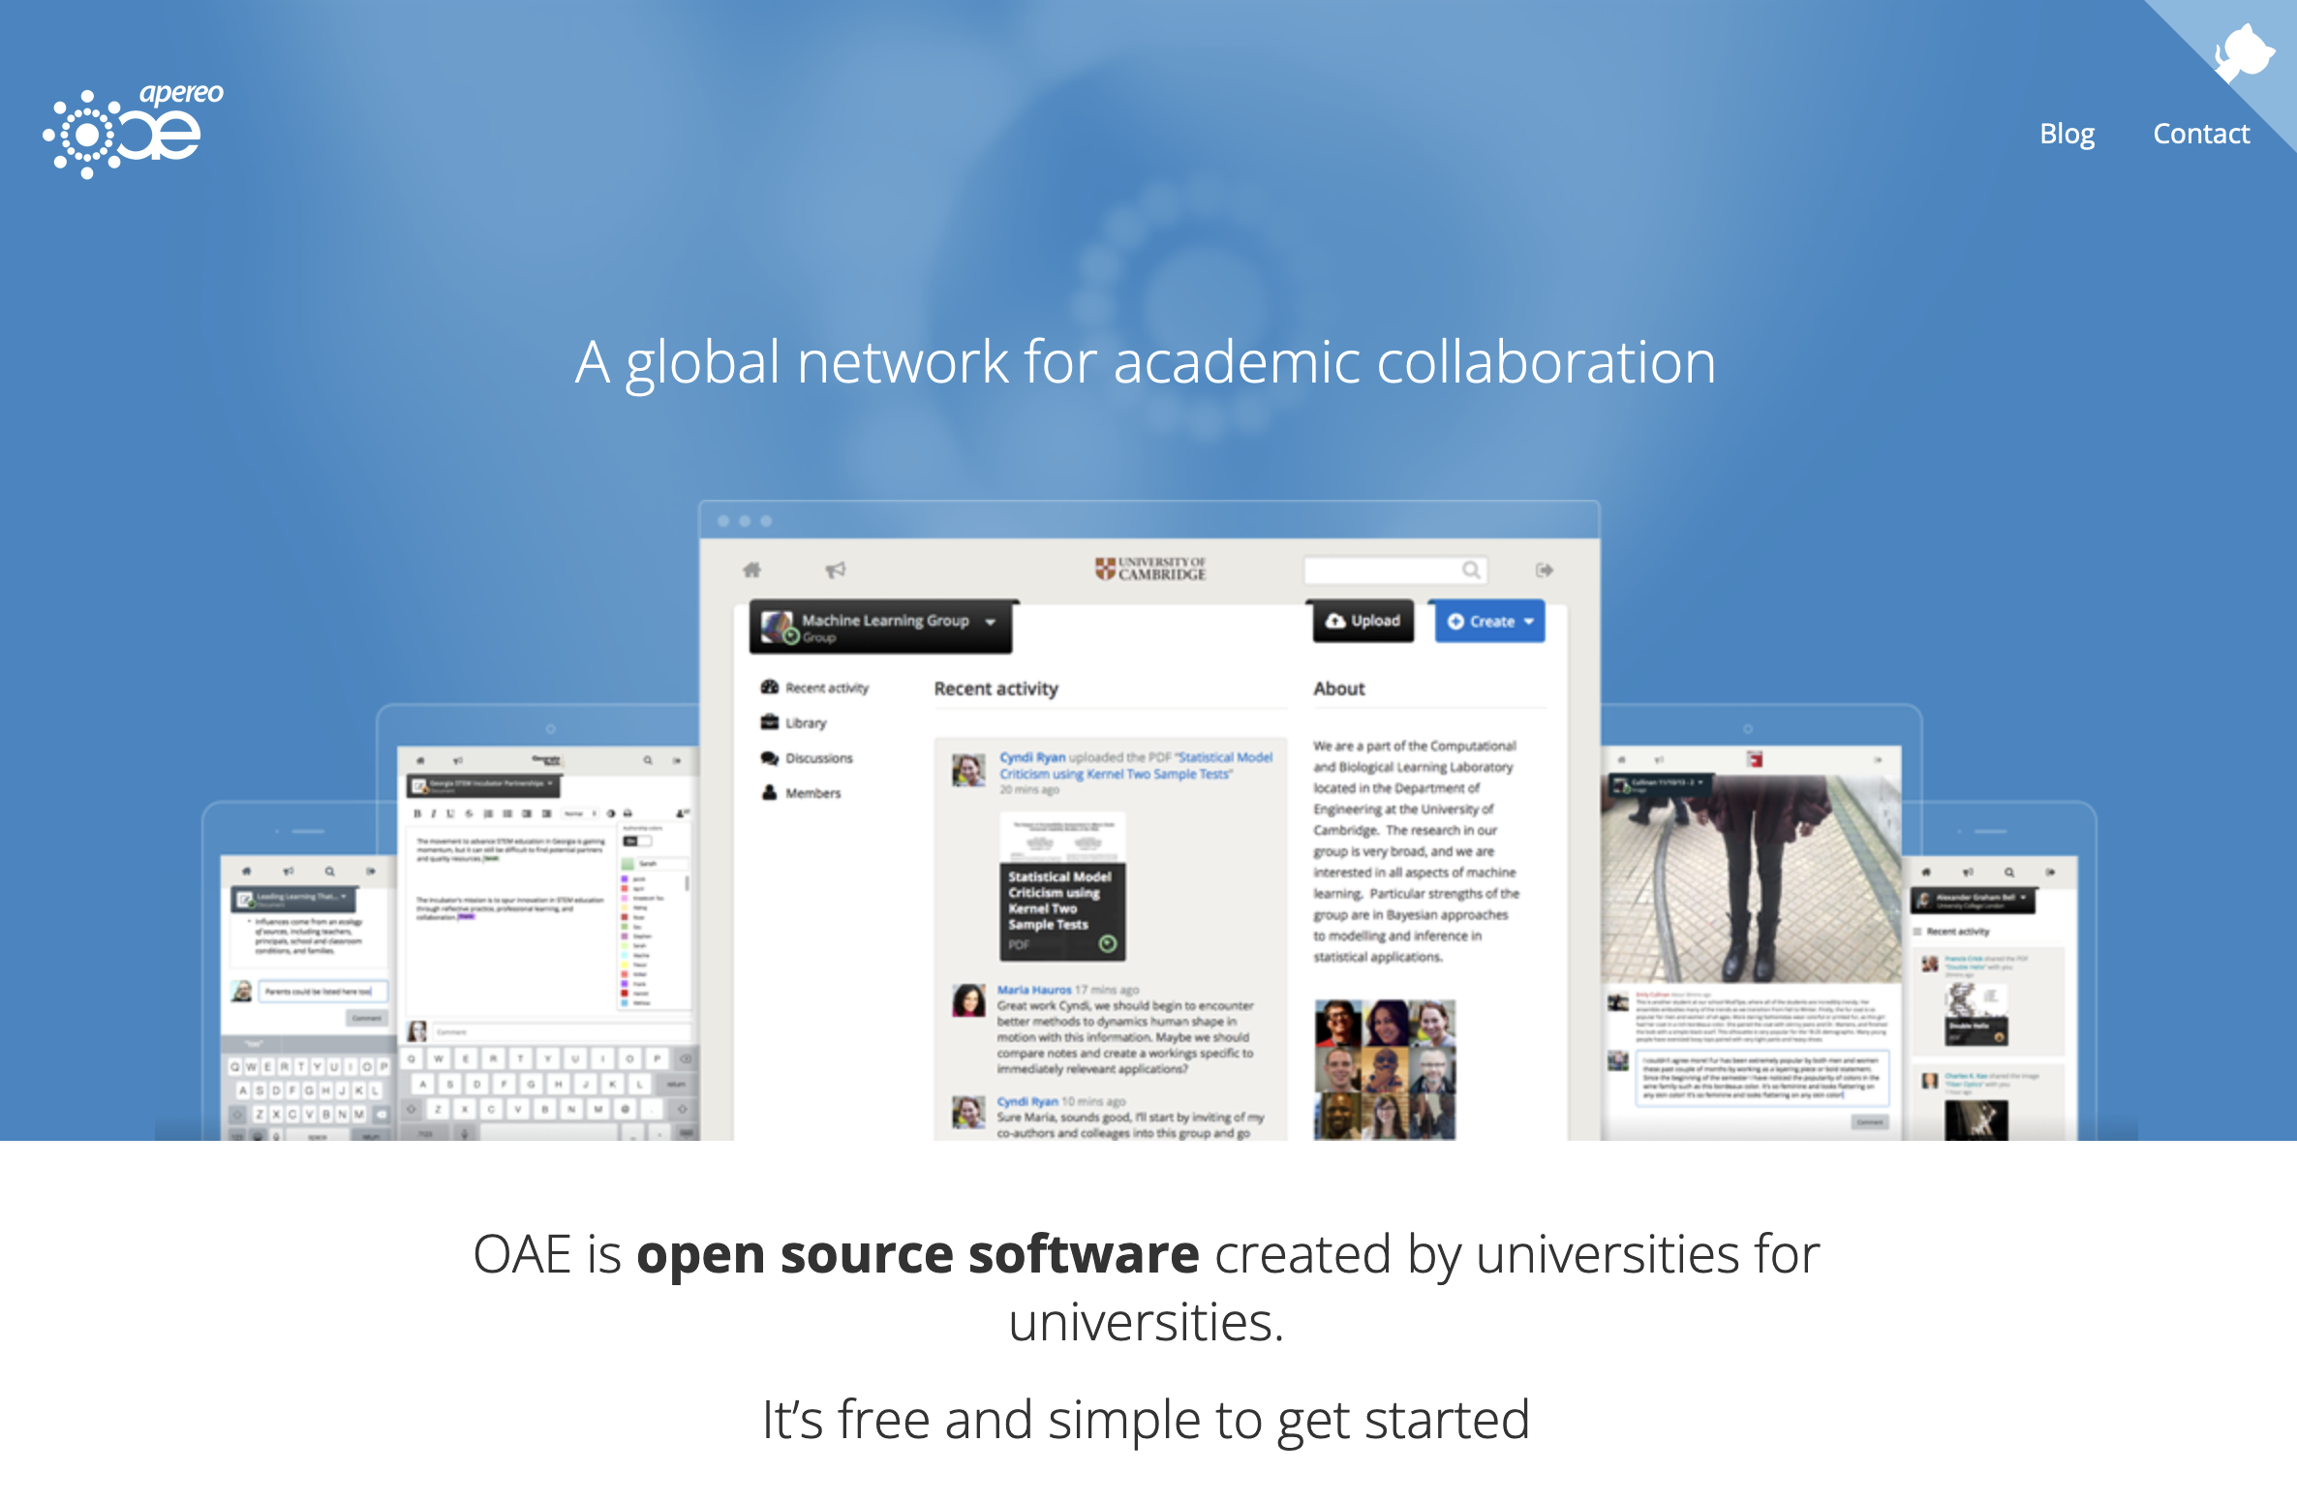
Sakai 3 / Open Academic Environment
The first Sakai rewrite started in 2008, confidence was very high and was scheduled to be 100% complete by 2009
It did not go well and had to be restarted with even newer technologies and new teams
2009, 2010, 2011, and 2012
A *lot* of university money was spent

Slide 17
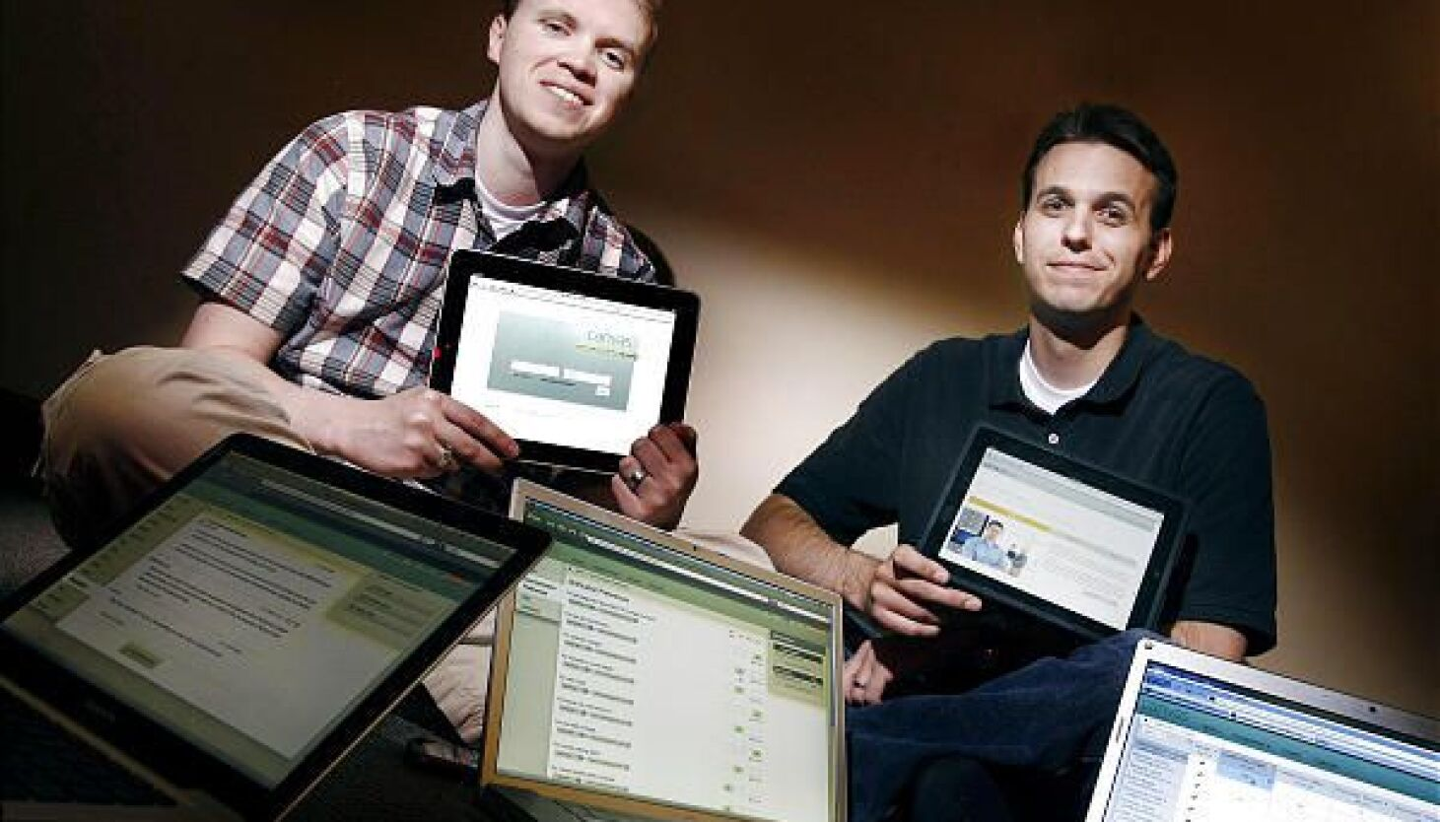
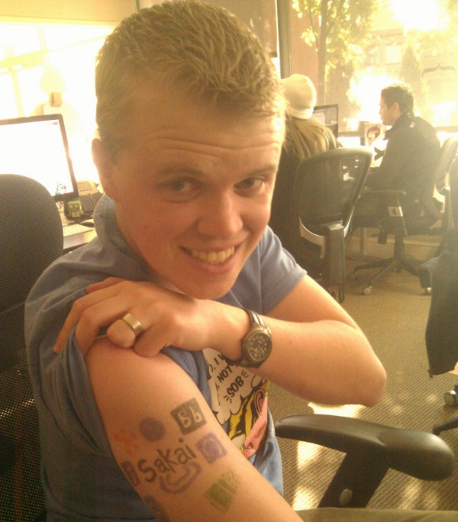
Meanwhile in Utah in 2008
Two BYU grad students looked at Sakai, its rewrite project, and reduced investment in the Java version of Sakai and thought, "Lets do the rewrite in Ruby on Rails!"
A rewrite would be easy ---- right?
Sakai OAE had broad dreams
Canvas greatly reduced functionality

Slide 18
Canvas was a Successful Rewrite of Sakai
Between 2002 and 2008, JavaScript changed everything
Sakai maintained a JavaScript-not-required UI until mid-2004
jQuery was released in 2006 and widely used
Between 2002 and 2008, Web services changed completely
Sakai used SOAP in 2004 – It was best practice back then ☺
Canvas started with REST (well supported in Ruby on Rails in 2008)
Standards changed a lot between 2002 and 2008
Sakai invented the standards and promoted them
Canvas implemented LTI and Common Cartridge better than any other LMS

Slide 19
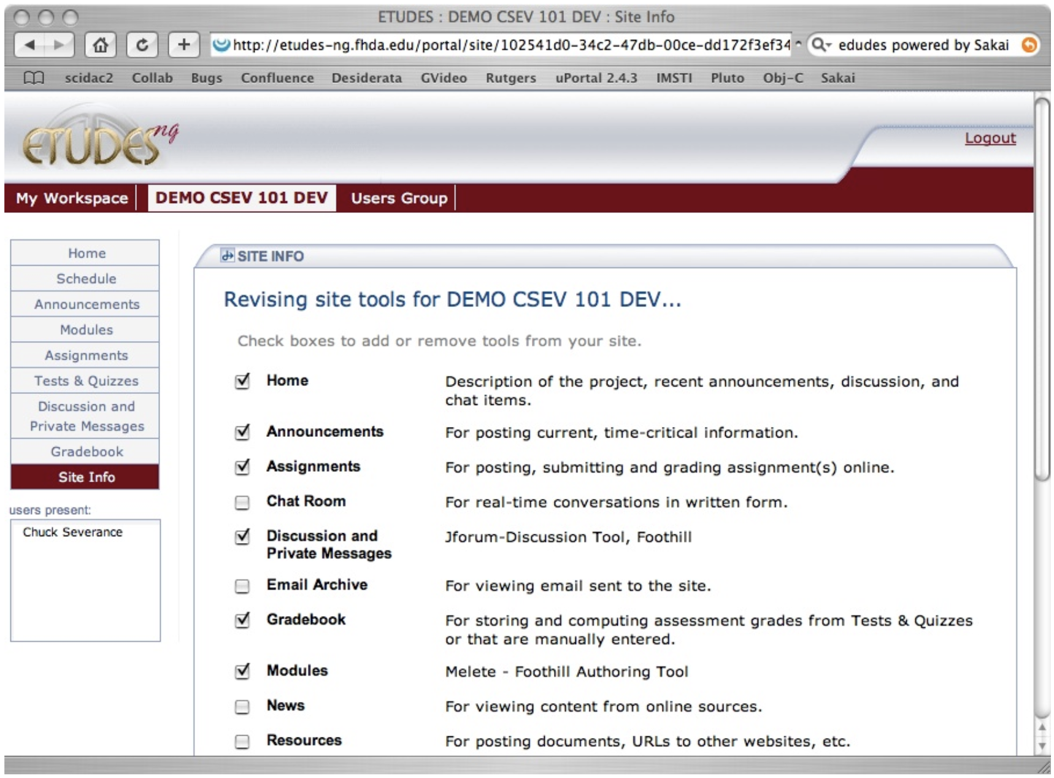
The architecture, UI, and interaction design of Canvas came from studying Sakai in 2007 and simplifying it.
Canvas was a Successful Rewrite of Sakai

Slide 20
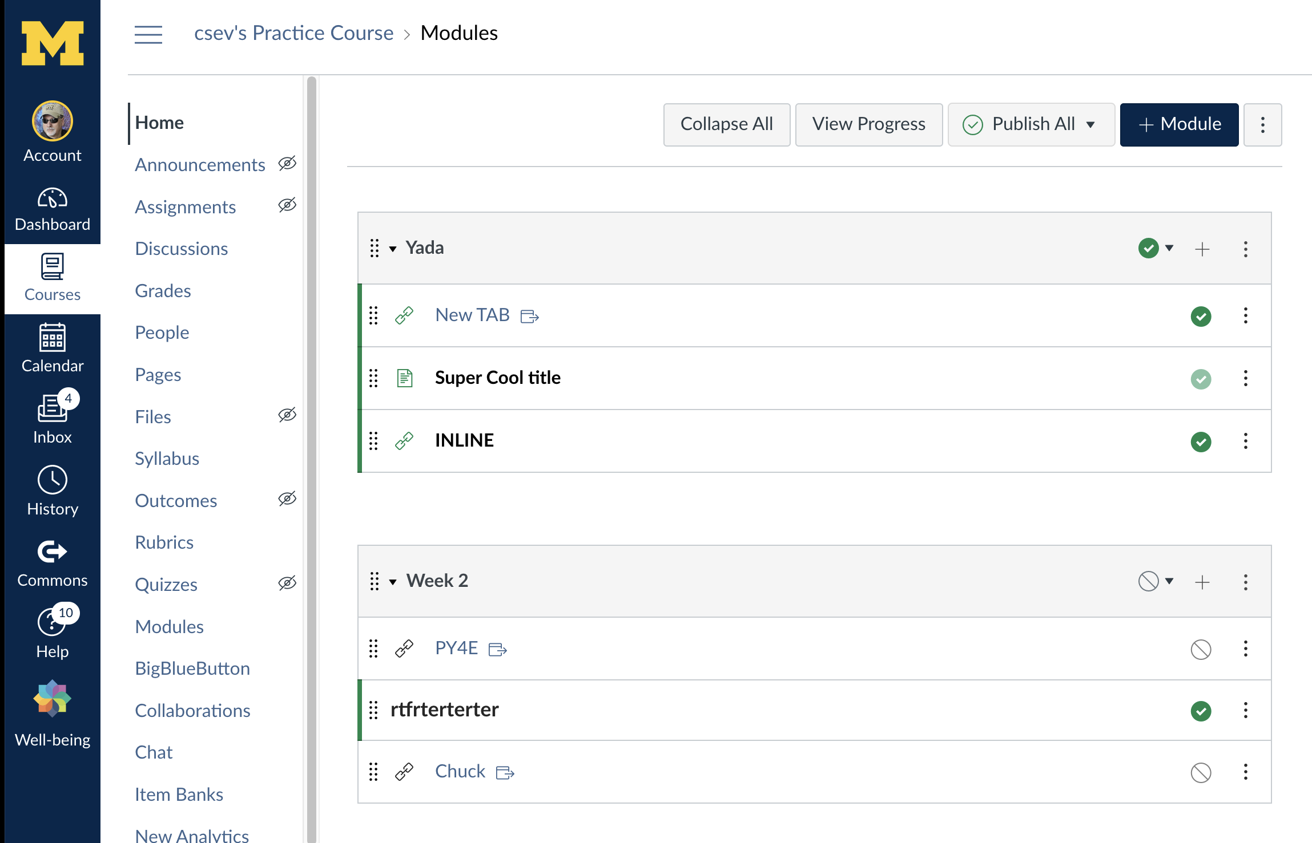

Slide 22
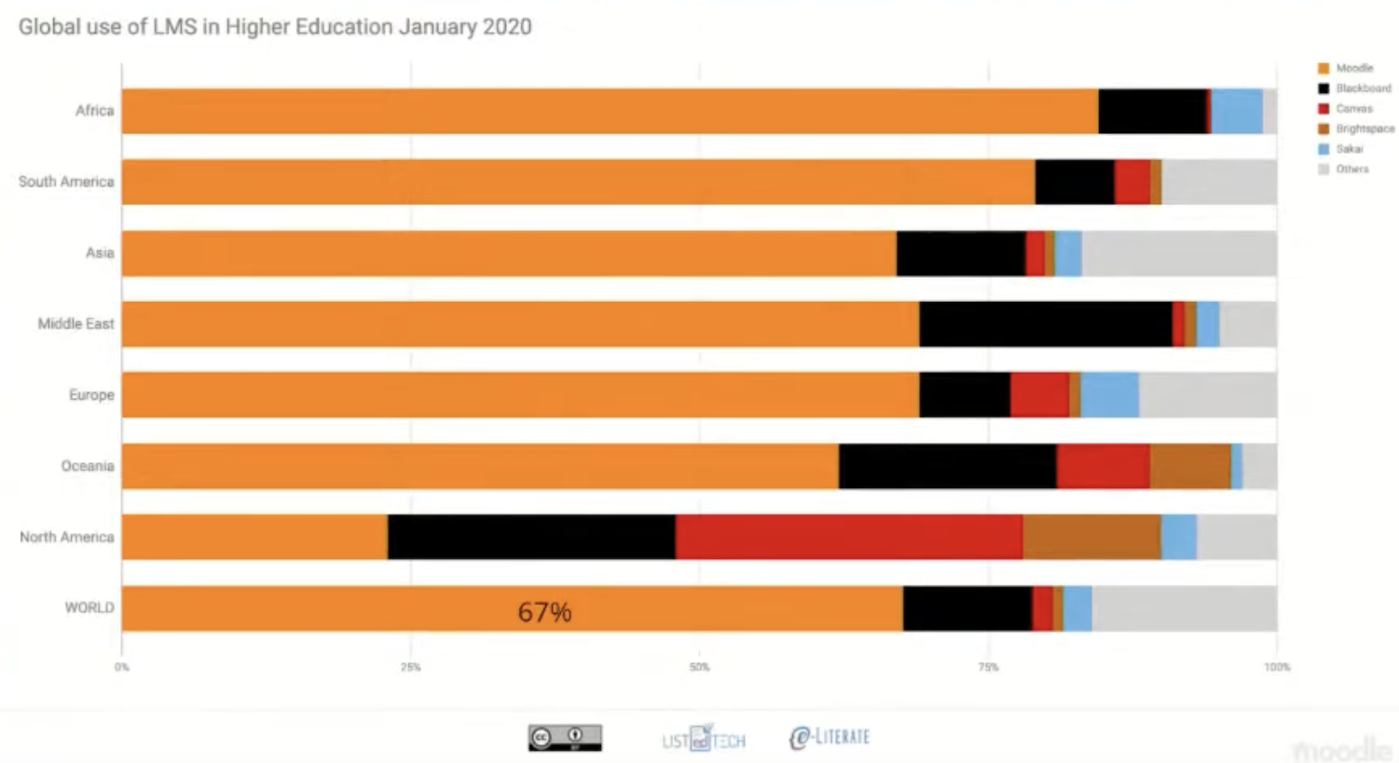
Canvas is #1 where Moodle is not #1

Slide 23
Refocusing on the Sakai Java code base
Between 2008 and 2018, many things changed
Ruby on Rails was no longer cool
Endless revolutionary ideas were cool for a year or two then faded
NoSQL, Backbone, Angular, Scala ..
Java had major investment and became one of the most viable and widely used web frameworks
Annotations, Spring, Java Persistence Architecture, Thymeleaf …
It took some time, but Web Components are part of the browser
Sakai just stayed with its Java code base ad made it better

Slide 24
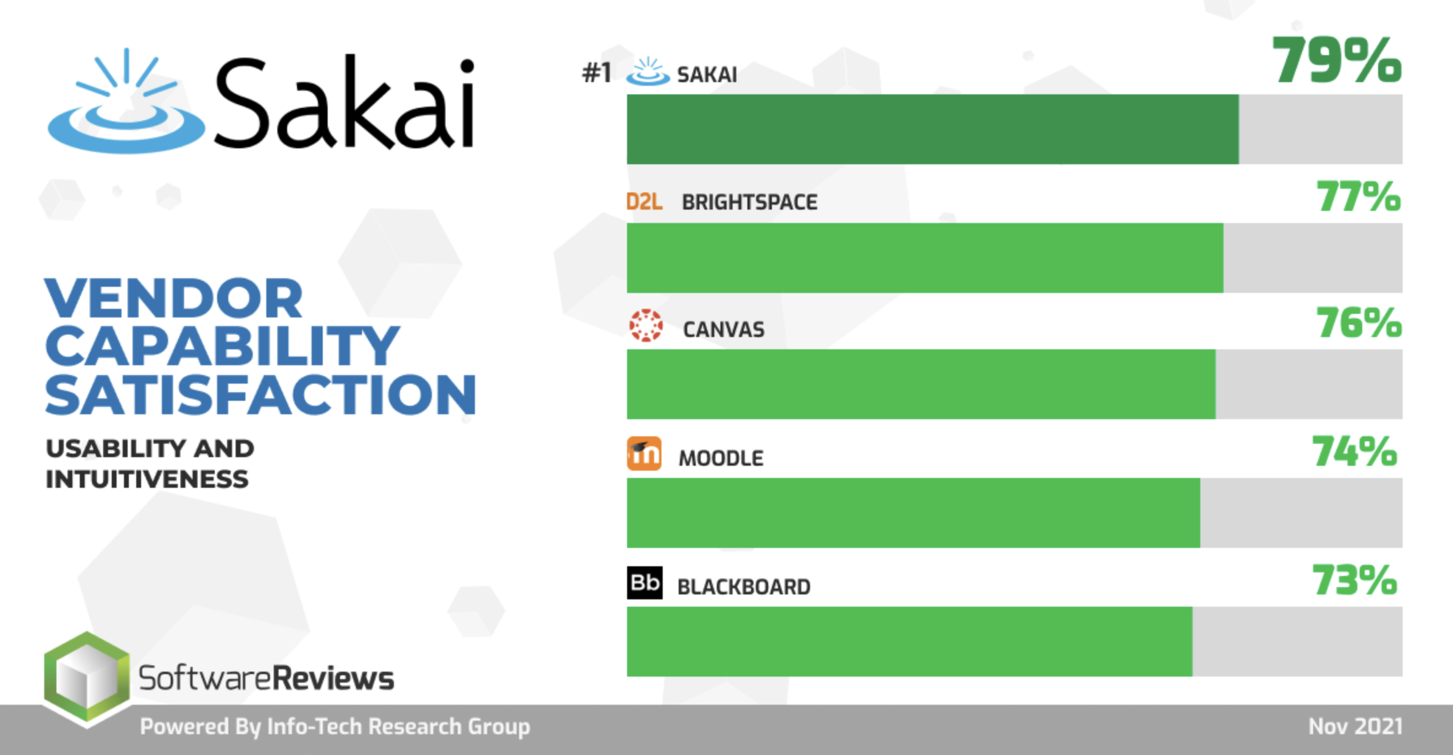

Slide 25
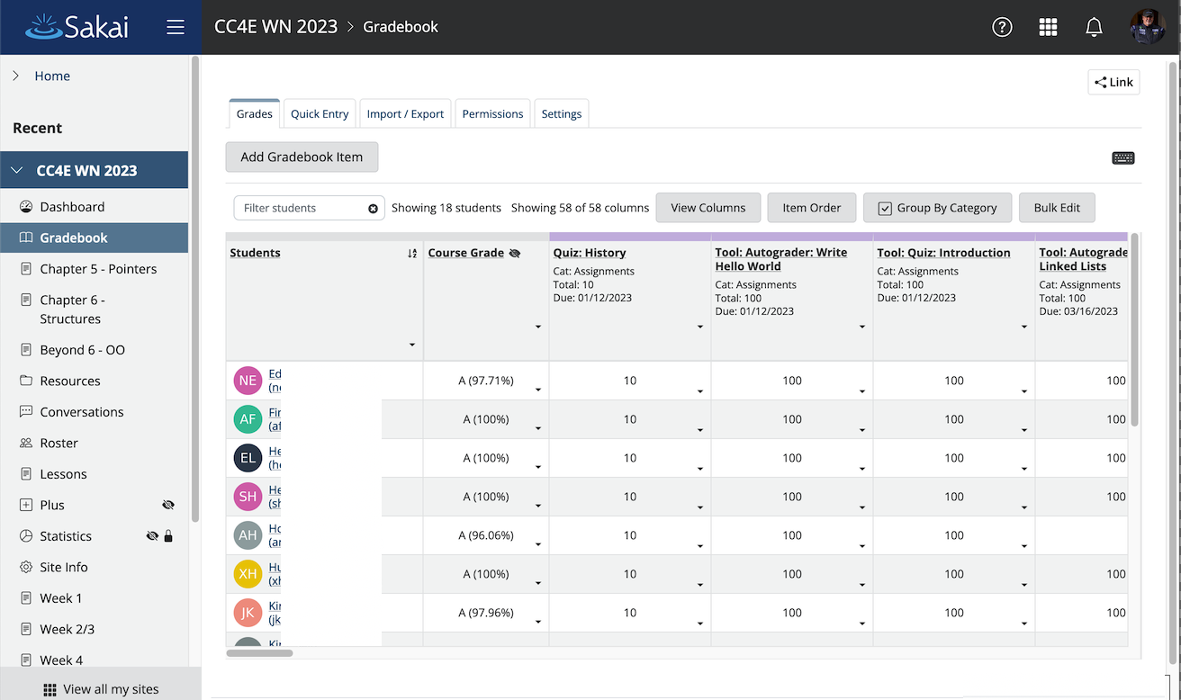

Slide 26
Sakai Leadership Going Forward

Slide 27
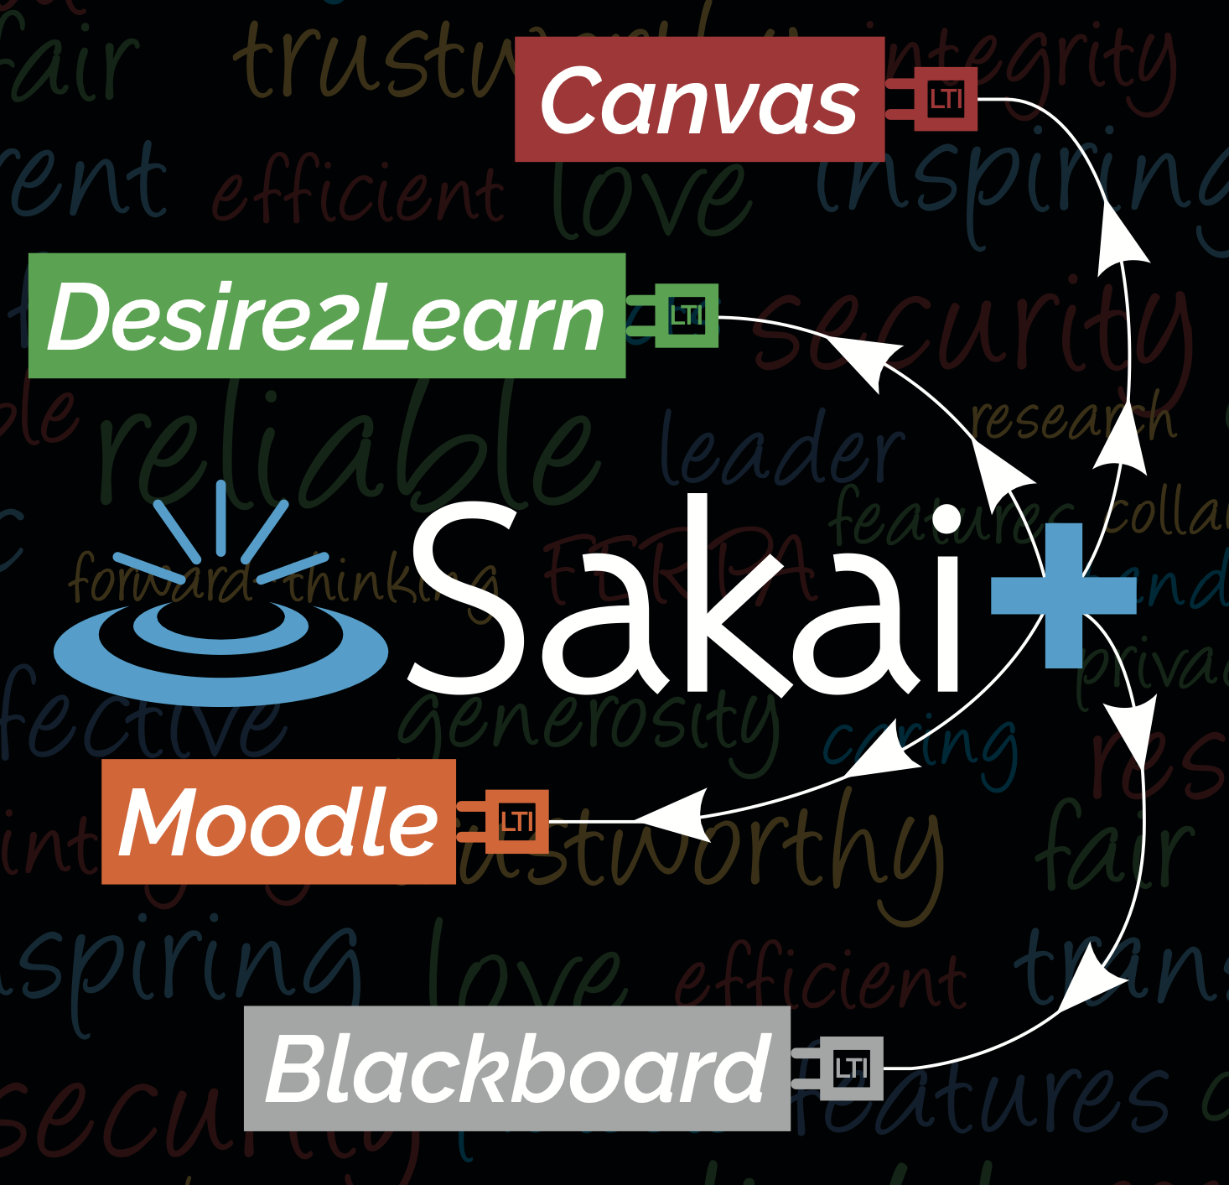
SakaiPlus
Part of Sakai 23
Pretty interesting to schools that never even used Sakai
Also interesting to schools transitioning off Sakai
Real multi-tenant hosting keeps costs of small instances really low
Can help sustain SakaiLMS as an Enterprise LMS for years if successful

Slide 28
Beyond SakaiPlus
????

Slide 29
If you were to build an LMS in 2024…
Standards would be at the core
The overall architecture / decomposition
The "internal design documents"
The web services
There would be a complete separation between UI/UX on the front end and service implementations on the back end
Progressive Web Application
Augmented Reality
Video Game Console
Television Application

Slide 30
What is an LMS?
Course Authoring – Common Cartridge
Enrollment Management - OneRoster
Course Management Runtime – LTI Advantage
Tool Orchestration – LTI
Roster Orchestration – Names and Roles
Grade Book – Outcomes
Course Tracking – Caliper / XAPI
Other things like Rubrics / Competencies and Academic Standards

Slide 31
Why Rewrites Fail or Take a Long Time
We start with a small team of 4-5 fresh, excited developers
Brand new tech stack – decided on at the first meeting of the five devs
Little awareness of the legacy product
Little awareness of the myriad of use cases that are represented un the legacy product
Are told to get back to basics and write a simple system with gradebook, files, quiz engine, and a threaded discussion
Don't talk to any teachers or instructional designers
We give you 12 months
We talk up the new project and kind of ignore the legacy project

Slide 32
The History of LMS Rewrites
WebCT Vista – Killed the company
Blackboard Learn – Took far longer than expected, eventually they invested enough in Blackboard Basic to bridge the gap
Sakai 3.0 – Pitched the code and restarted with a new team and leadership – four times! Pitched the tech stack a few times.
Canvas – Took 4 years with a 2 year friendly customer beta period
Blackboard Ultra – Took a break, slowed down, kept legacy in place, focused on moving to the cloud and getting rid of Oracle, regret the choice of Angular

Slide 33
What if…
We had a team of 10 developers deeply connected to a community of teachers , instructional designers, and students
Experts in developing a production / scalable LMS
Experience in choosing new tech stacks and then living with that choice years later
Experienced in the complexity required in a new LMS
Able to continuously bring new ideas from the rewrite back to the legacy LMS and put them into production with real users
And we gave them 3-5 years
We learn from the mistakes of WebCT Vista, Sakai 3.0, Blackboard Learn, Blackboard Ultra and emulate the success of Canvas

Slide 34
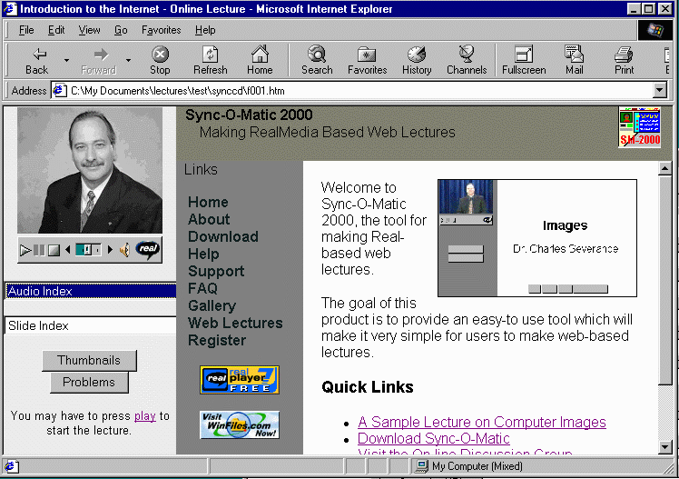
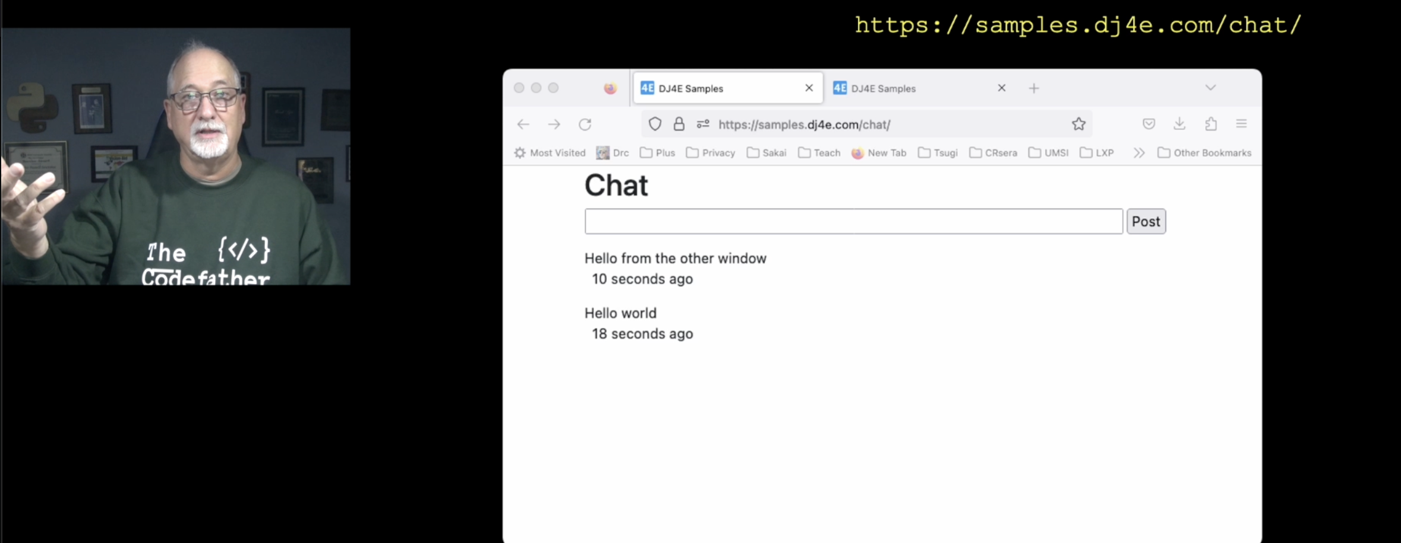
As a Teacher…
I use many LMS's
Canvas
Sakai
Tsugi
Coursera
edX

Slide 35
As a Teacher…
I use many LMS's
Canvas
Sakai
Tsugi
Coursera
edX
I don't like any of them particularly well (5/10)

Slide 36
As a Teacher…
I use many LMS's
Canvas
Sakai
Tsugi
Coursera
edX
I don't like any of them particularly well (5/10)
But the superset of the ideas *across* all these systems in a smooth, well integrated set of components would change my teaching forever

Slide 37

We are at a unique moment in time…

Slide 38
We are at a unique moment in time… Just like we were 20 years ago.

